Slide 1

Bean Validation
Dima Ionut Daniel

Slide 2
Contents
What is Bean Validation?
What is validation?
Constraints
Core Classes
XML Configuration
Example
Implementations
Conclussion
Bibliography

Slide 3

What is Bean Validation?
Java Bean Validation (JSR 303) is part of Java EE 6 specification.
Bean Validation defines a metadata model and API for JavaBean validation.
The metadata source is annotations, with the ability to override and extend the meta-data through the use of XML validation descriptors.
The Hibernate team provides with Hibernate Validator the reference implementation of Bean Validation.

Slide 4
What is validation?
Process, store, retrieve data
Constraint our model
Ensure data is valid
The service will behave correctly
Give feedback to the users

Slide 5
What is validation? (cont)
“Constrain once, validate anywhere”
Reuse the constraints
Standard way to validate constraints
Use already defined constraints
Customize own constraints

Slide 6
Constraints
@NotNull → value must be not null.
@Null → value must be null.
@Digits → the value must be number within a specific range.
@Max → value must be an integer value lower or equal to number in the value.
@Min → value must be an integer value greater or equal to number in the value.
@Past → the value of the field must be a date in the past.
@Future → the value of the field must be a date in the future .
@Size → the size of the field is evaluated and must match the specified boundaries.
@Pattern → the value of the field must match the regular expression.
@DecimalMax →the value must be a decimal value lower or equal to the number in the value element.
@DecimalMin → the value must be a decimal value greater or equal to the number in the value element.

Slide 7
Core Classes
The javax.validation.ValidatorFactory returns javax.validation.Validator instances.
The implementations are thread-safe and instances are typically cached and reused.
The javax.validation.Validator instance validates bean instances.

Slide 8
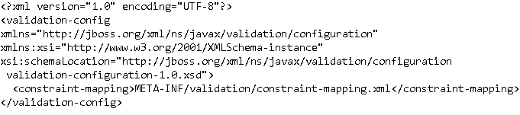
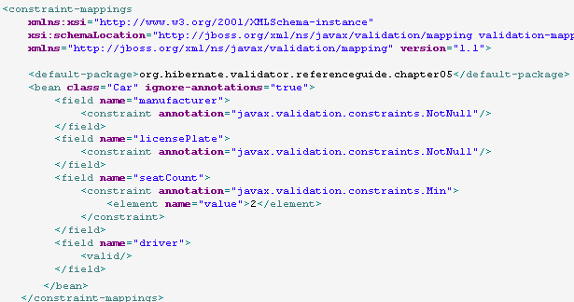
XML Configuration
Instead of using annotations we can use the META-INF/validation.xml
The constraint-mapping.xml file contains beans validation declarations.

Slide 9
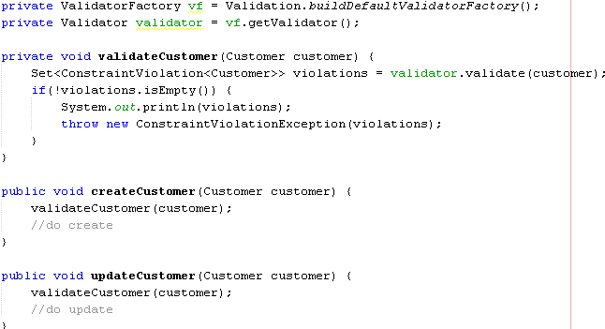
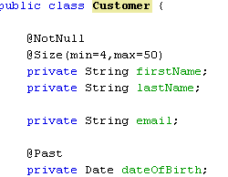
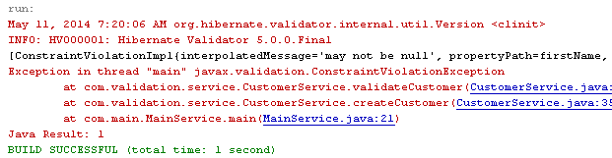
Example

Slide 10
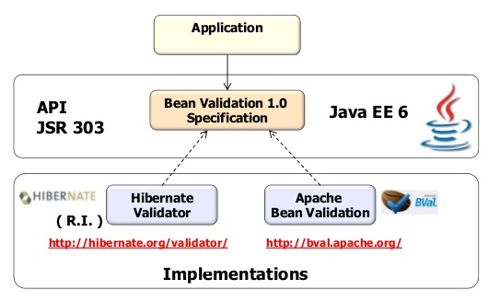
Implementations

Slide 11
Conclussion
Bean Validation is easy to use.
Error messages can be parameterized.
Configuration can be done using XML or annotations.
Custom validators can be defined.

Slide 12

Bibliography
http://en.wikipedia.org/wiki/Bean_Validation
https://docs.jboss.org/hibernate/validator/

Slide 13
Questions ?

